Slide 2
Variables- Response=Gross
Categorical
Year
Genre
Sequel(?)
Continuous
Year
Genre
Ratings
Budget
Screens
Sentiment
Views
Likes
Dislikes
Comments
Aggregate Followers
Sequel(?)

Slide 3
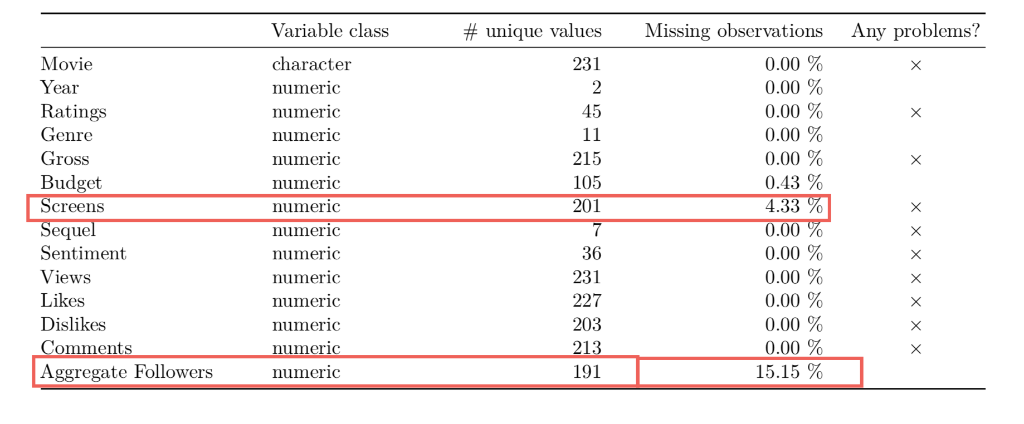
Missing Values

